Slide 1
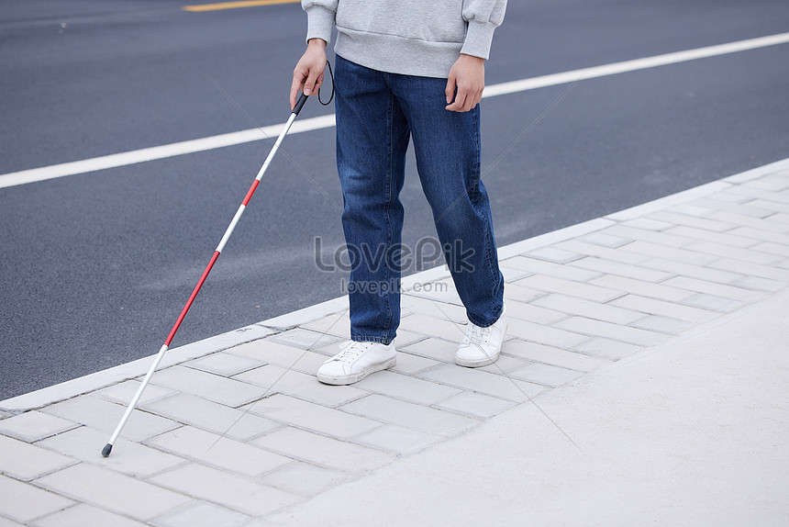

Title:
Smart Blind assistance stick

Slide 2
Background:
About 2 percent of people in India suffering from lack of vision . These people always depend on other to carry out their daily routine .Even in their own home they need some persons to take care of them to navigate across their various rooms in their home and to identify the things in their house. So there is requirement of assistance for them
Limitations of Existing Solutions:
Traditional aids like white canes are effective to some extent but have limitations in terms of providing comprehensive real-time navigation information and obstacle detection.
Human assistance is not always available.
To provide assistance for the blind people. From the knowledge of Robotics . To make them independent.

Slide 3
Executive Summary:
my project aims to help blind people be more independent and empowering them to navigate and interact with the world around them with confidence .
.
WORKING:
Users simply hold the stick while navigating through indoor environments. The stick utilizes advanced technologies like lidar and SLAM to create real-time maps and detect obstacles, ensuring safe and efficient navigation. Additionally, the stick incorporates voice assistance and a camera module for enhanced interaction and environmental awareness . So this device empowers users, enabling them to independently explore their surroundings, confidently interact with others.

Slide 4
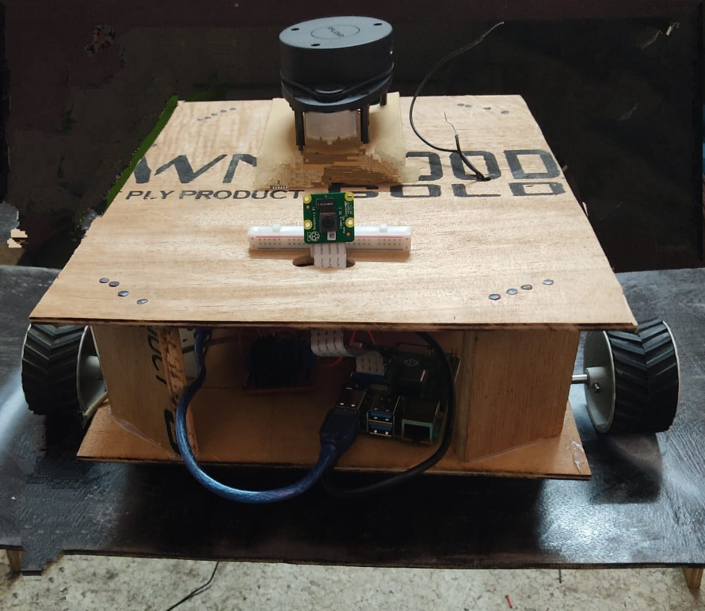
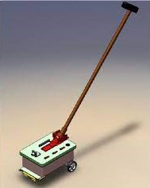
Smart blind assistance stick
1 Holding Stick
2 Camera Module
Four wheeler differential drive with lidar
Microphone and speaker for voice assistance

Slide 5
Methodology:
MAPPING MECHANISM:
We will build a map of our environment using the ROS Packages like SLAMTOOLBOX. SLAM is an algorithm that uses laser scan data to create a map. We can perform the Navigation using the Nav2bringUp package.
SLAM is a popular technique in which a robot generates a map of an unknown environment (i.e. mapping) while simultaneously keeping track of its position within that map (i.e. localization).
IMAGE PROCESSING:
Using Haar cascade algorithm face detection will be done. And using basic algorithms we can perform the object detection.
VOICE ASSISTANCE:
PICROFT is an open source voice assistant provided for Raspberry-pi. Using this we can build our own voice assistant that
Takes our voice commands.
TECH STACK:
Raspberry-pi with ubuntu
OpenCV
PICROFT
ROS

Slide 6

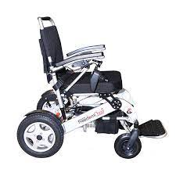
Future Developments
Development of a Smart Blind Scooter.
The Smart Blind Scooter will provide a more robust and versatile mobility solution, allowing individuals to stand and comfortably navigate their surroundings
Development of a Smart Wheel chair.
The Smart wheel chair will allow not only the blind but also the Old people also to sit comfortably and navigate their surroundings

Slide 7
Conclusion :
The Smart Blind Assistant Stick: Empowering Independence
A groundbreaking innovation for blind individuals.
Integrates lidar, SLAM, facial recognition, and voice assistance.
Boosts confidence, enables safe navigation, and fosters social interaction.
Commitment to accessibility, affordability, and continuous improvement.
Together, let's create a future of autonomy and inclusivity.
THANKING YOU

